Slide 1

Data Models used in REST API
(JSON, XML and YAML)
Madhuri Dewangan
Security Consulting Engineer

Slide 2
Agenda list
1
Data Model & Its Importance
6
Data Model in REST API
2
API, REST API & Its Usage
7
Different Data Models
3
REST API & HTTP
8
JSON
4
HTTP Method
9
XML
5
HTTP Packets
10
YAML

Slide 3
Data Models and Its Importance
Enables users to organize data and standardize in a way that it can help its consumption easily.
Defines structure of data.
Helps characterize an entity
Easy Storage of Information and Retrieval.
Physical Entity
Data Model
Person
{
Name : ”Shristi”,
Age : 24,
Height : 168,
Education : ”Masters of Information Techonology”,
Occupation: ”Consulting Engineer”,
Hobbies : [“Cooking”, “Calligraphy”,
”Dancing”,
”Trekking”]
EMP ID : 345
}
Hobbies
Age
Occupation
Height
Name
Education
EMP ID

Slide 4
API & REST API
API: API stands for application programming interface
Set of rules that allow programs to talk to each other. The developer creates the API on the server and allows the client to talk to it.
REST: REST stands for “Representational State Transfer”.
Set of rules that developers follow when they create their API.
REST transfers current state of object.

Slide 5
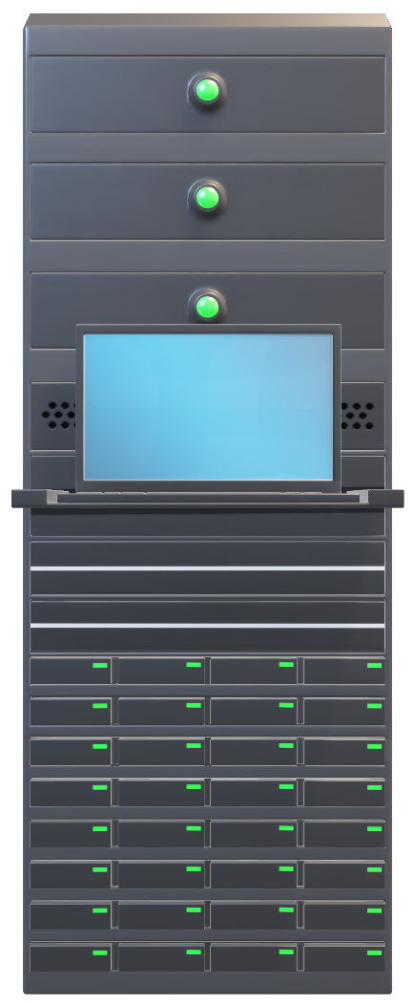
Why Do we need APIs?
Fetch Detail of Emp ID 345
API
HTTP Request : Details of Employee having ID 345
Repetitive Task, Can I Automate this!!!?
HTTP Response : {Shristi of Age 24Yrs having Height 168m
studied Masters of Technology,
Working as Consulting Engineer}
Saurav

Slide 6
Request, Response and its Parameters
Communication between Client and Server occur over HTTP Request and Response Packet
GET /User/Employee
Host: localhost:8000
Connection: keep-alive
Content-Type: application/json
Content-Length: 345
User-Agent: Mozilla/4.0
Keep-Alive: timeout=5, max=1000
empID=345&name=‘Shristi’
Client
Server
/User/Employee
REST Interface
HTTP /1.1 200 OK
Date:: Sun 18th April 2020 03:30:45 GMT
Server : Apache/1.2.29(Win32)
Last-Modified: Sun, 18th April
Content-Tyoe: application/json
Content-Length: 345
{ Name:”Shristi”, Age:24, Height: 168,Education:”Masters of Information Techonology”, Occupation:”Consulting Engineer”, Hobbies:{“Cooking”, “Calligraphy”,”Dancing”,”Trekking”}}

Slide 7
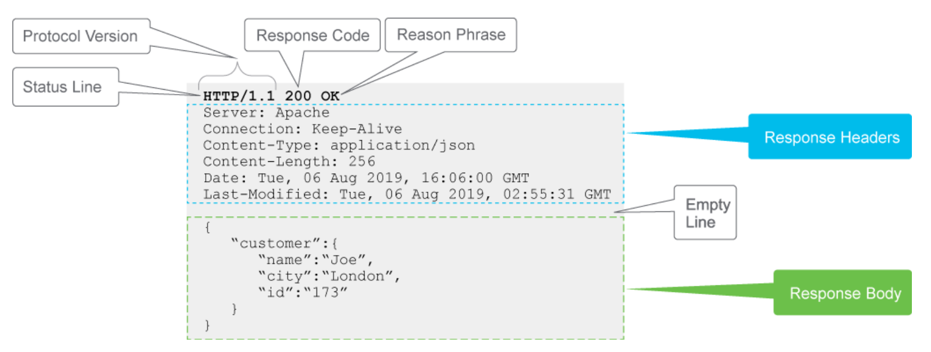
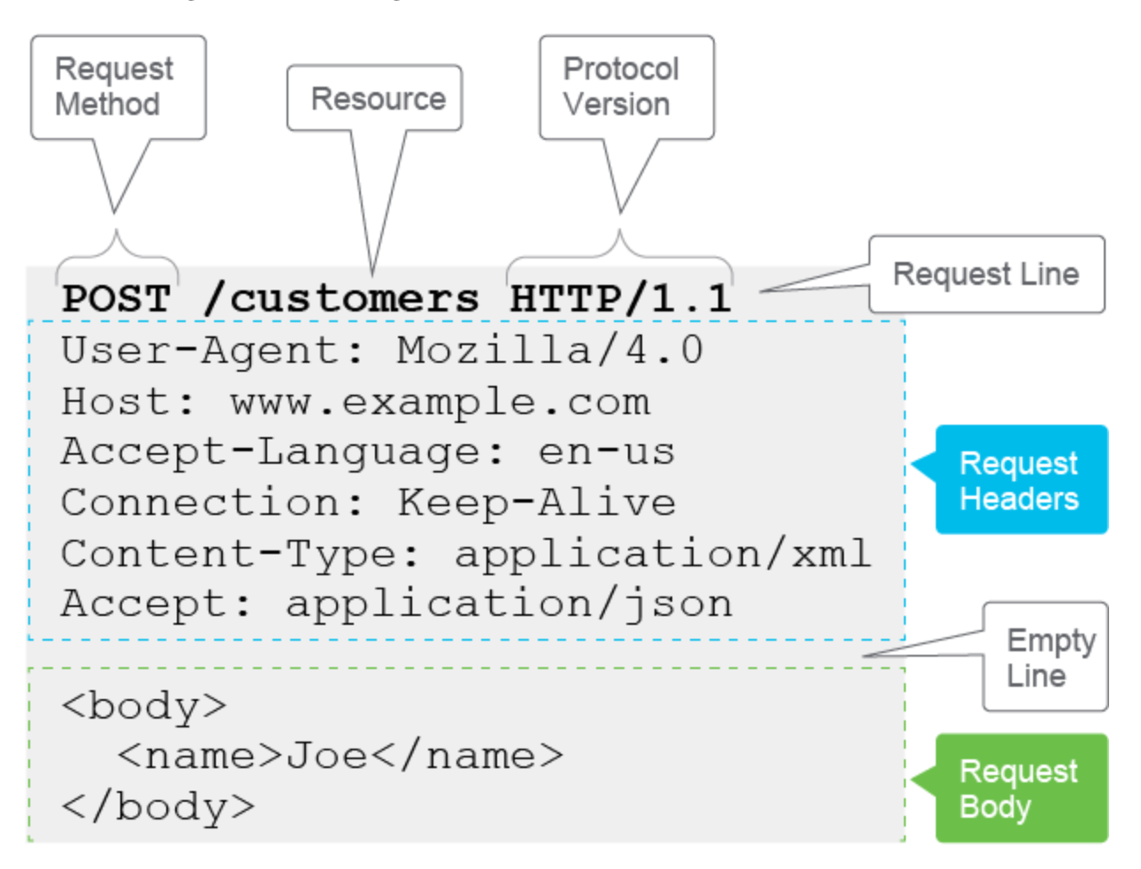
Request and Response Examples

Slide 8
Facts Check!!!
What is error code you will receive when you don’t have privilege to access the data in server, though you are successfully Authenticated?

Slide 9
Facts Check!!!
Is REST API and WEB APIs same?

Slide 10
REST API and HTTP
Most of the REST API uses HTTP as the Transport Protocol.
Since the infrastructure, servers and client libraries for HTTP are widely available already.
WEB API
SOAP API
REST API

Slide 11
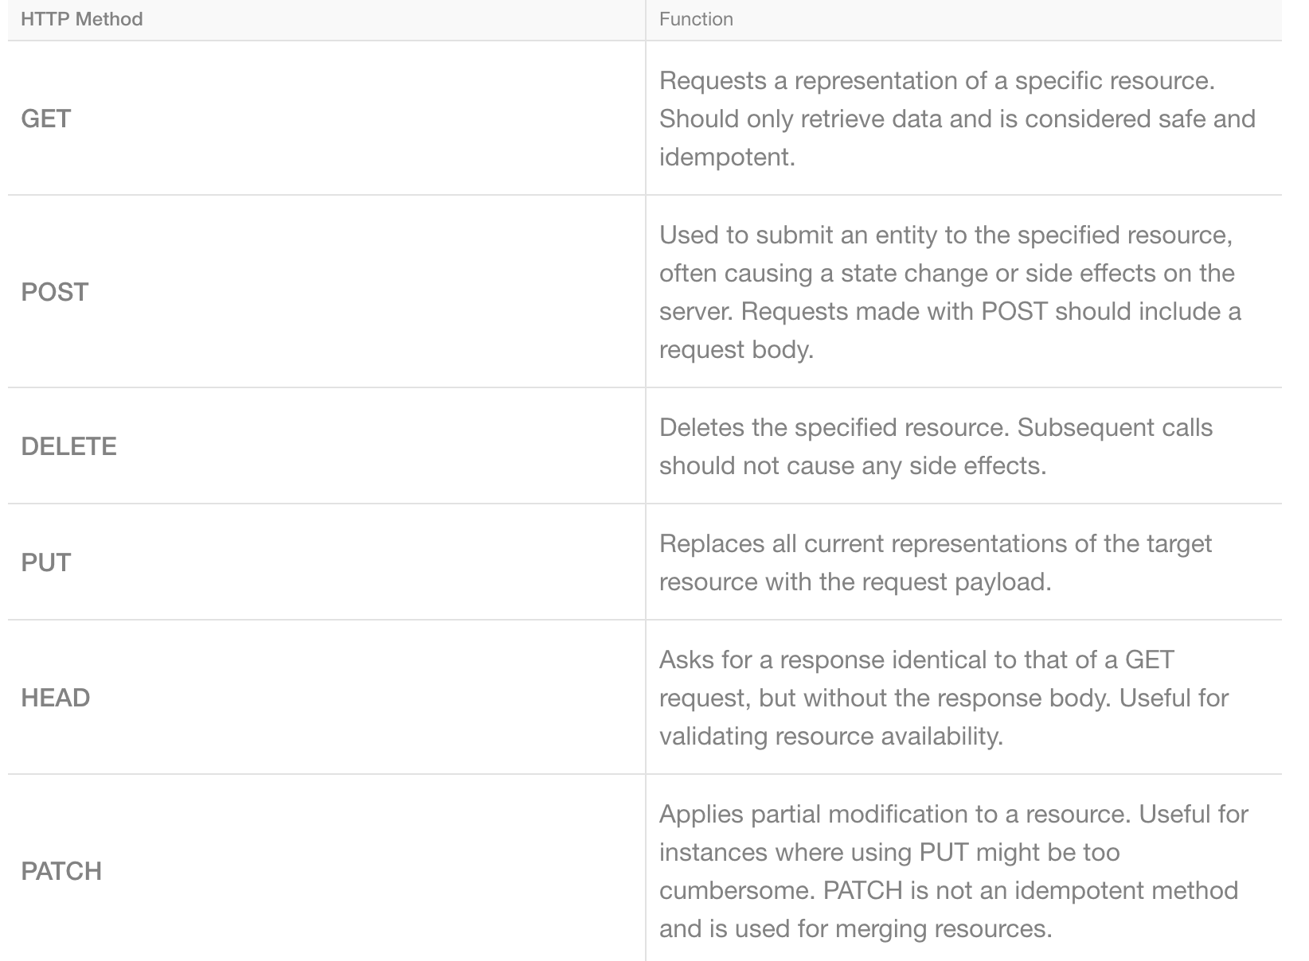
HTTP Methods Used for REST API

Slide 12
Facts Check!!!
Can we consider REST API to be our traditional database, as we do perform fetch and update and insert operation?

Slide 13
Why Data Model in REST API
Request
Response
GET /User/Employee
Host: localhost:8000
Connection: keep-alive
Content-Type: application/json
Content-Length: 345
User-Agent: Mozilla/4.0
empID=345&name=‘Shristi’
HTTP /1.1 200 OK
Date:: Sun 18th April 2020 03:30:45 GMT
Server : Apache/1.2.29(Win32)
Last-Modified: Sun, 18th April
Content-Type: application/json
Content-Length: 345
{ Name:”Shristi”, Age:24, Height: 168,Education:”Masters of Information Techonology”, Occupation:”Consulting Engineer”, Hobbies:{“Cooking”, “Calligraphy”,”Dancing”,”Trekking”}}

Slide 14
Facts Check!!!
How do we know which Data Model is supported by API of Interest?

Slide 15


API Documentation
Shruti has an idea to automate PSIRT report?
PSIRT Report Generator

Slide 16
Data Model Used for REST API
JSON
XML
YAML

Slide 18
Python Libraries for Data Models

Slide 19
JSON
Stands for JavaScript Object Notation
Syntax for storing and exchanging data.
Lightweight data-interchange format
Self-describing and easy to understand
Language independent.
This format was originally specified by Douglas Crockford.

Slide 20
When do we use JSON?
Storing Data
Getting user input from forms
Transfering data between systems
Configuration Files
Data Serialization

Slide 21
Parsing Python Object into JSON
Define Dictionary
"name""Shristi", "age"24, "city""Bangalore"
Instruction Python Interpreter to treat this Dictionary as JSON
json.dumps(dictionary object)
Access Elements of JSON
object[“element”]

Slide 22
JSON Live Example
GET Request with Basic Auth to fetch Access
Token to access API
1
2
Response has Access Token
3
GET Request to Server to fetch JSON
4
Response: Requested Data in JSON

Slide 23
Interpreting JSON using Python

Slide 24
XML
Human and machine-readable
Simplicity, generality, usability across the Internet
H/W or S/w Independent
Mostly used in SOAP based API

Slide 25
Facts Check!!!
What is difference between XML and HTML?

Slide 26
Processing XML using Python
Python library for processing XML document is ElementTree .
This library helps user to parse the Marked up data into desired variable.
XML is tree like structure where each element is marked by tags.
To parse this tree following are the steps:
Initialise object to be able to parse XML
tree = ET.parse(xmlfile)
2. Identify root of the tree.
root = tree.getroot()
3. Reach out to every child node:
for item in root.findall(‘employee'):

Slide 27
When do we use XML?
Data serialization
Define MeTADATA
Integrate with other Media type

Slide 28
Parsing XML Data Object
Identify Root of Tree
Getroot()
Find all Child Node
for item in root.findall(string to identify node):
Access Data in the Nodes
Item.get{id}

Slide 29
Facts Check!!!
Is <tag>value</TAG> is same as <tag>value</tag>?

Slide 30
Interpreting XML using Python

Slide 31
YAML
Data serialization language.
Design Goals: Simplicity, Generality and usability
Configuration files and log files
Notes:
Data serialization language which is designed to be human -friendly and works well with other programming languages for everyday tasks.

Slide 32
Basics of Defining a YAML File
Comments in YAML begins with the (#) character.
Comments must be separated from other tokens by whitespaces.
Indentation of whitespace is used to denote structure.
Tabs are not included as indentation for YAML files.
List members are denoted by a leading hyphen (-).
List members are enclosed in square brackets and separated by commas.
Associative arrays are represented using colon ( : ) in the format of key value pair. They are enclosed in curly braces {}.
Multiple documents with single streams are separated with 3 hyphens (---).
Repeated nodes in each file are initially denoted by an ampersand (&) and by an asterisk (*) mark later.
YAML always requires colons and commas used as list separators followed by space with scalar values.
Nodes should be labelled with an exclamation mark (!) or double exclamation mark (!!), followed by string which can be expanded into an URI or URL.

Slide 33
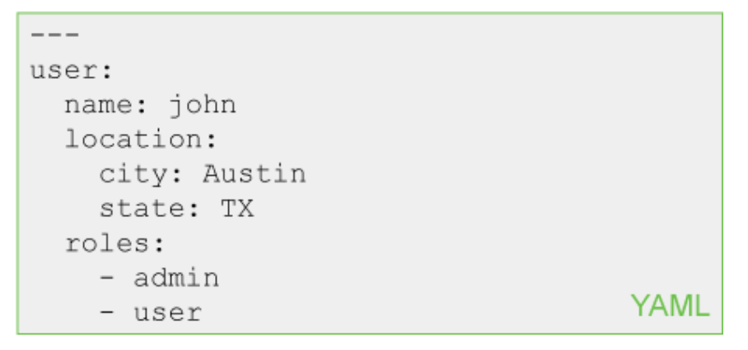
Example of YAML

Slide 34
When we use YAML?
Data Serialization
Configuration File
Data Transmission

Slide 35
Parsing Python Object into YAML
Define Dictionary
"name""Shristi", "age"24, "city""Bangalore"
Instruction Python Interpreter to treat this Dictionary as YAML
yaml.load(dictionary object)
Access Elements of YAML Object
object[“element”]

Slide 36
Interpreting YAML using Python

Slide 37
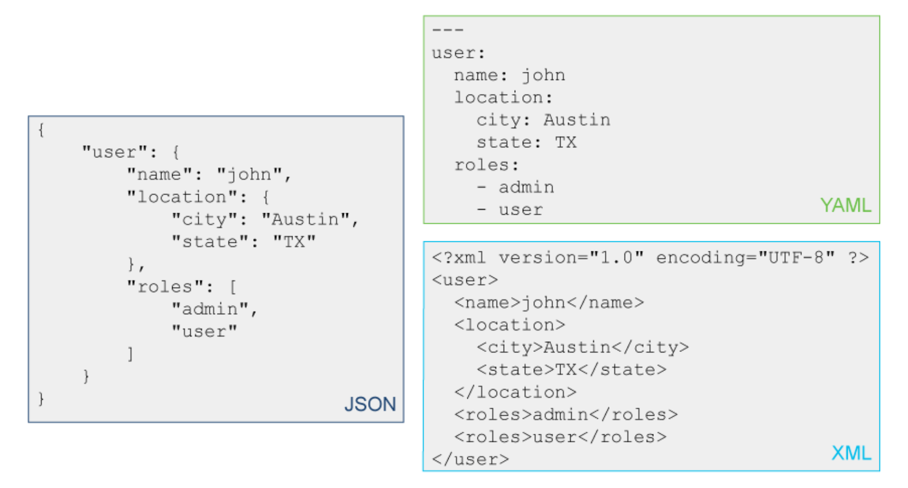

Slide 38
References:
https://www.w3schools.com/python/python_json.asp
https://www.tutorialspoint.com/yaml/index.htm
https://www.w3schools.com/xml/
https://www.geeksforgeeks.org/xml-parsing-python/

Slide 39
Questions!

Slide 40
Excersice
1. Code to convert given JSON to XML
{
Name : ”Shristi”,
Age : 24,
Height : 168,
Education : ”Masters of Information Techonology”,
Occupation: ”Consulting Engineer”,
Hobbies : [“Cooking”, “Calligraphy”,
”Dancing”,
”Trekking”]
EMP ID : 345
}
2. Code to read Hobbies from the XML object created in Task 1

